Slide 1
Unit- 2 IoT Protocols
Dr. Madhukrishna Priyadarsini
Department of CSE

Slide 2
Outline
IP Versions
Need for Optimization(Constrained Nodes and Constrained Networks)
Optimizing IP for IoT (6LoWPAN to 6Lo, Routing)
Application Transport Methods (Supervisory control and data acquisition)
Application Layer Protocols (CoAP and MQTT)

Slide 3
Chapter 5: IP as the IoT Network Architecture
Internet protocol (IP): is the backbone network of both IT and OT environment.
Key advantages of IP protocol:
Open and standards-based
Versatile
Ubiquitous
Scalable
Manageable and highly secure
Stable and resilient
Consumers’ market adoption
The innovation factor

Slide 4
Adoption or Adaptation of the IP
Adoption: application layer gateways (ALGs) must be implemented to ensure the translation between IP and non-IP layers.
Adaptation: involves replacing all non-IP layers with their IP layer counterparts, simplifying the deployment model and operations.
Factors affecting the last-mile connectivity:
Bidirectional Vs unidirectional data flow
Overhead for last mile communication paths
Data flow model
Network diversity

Slide 5
Thee Need for Optimization
Constrained Nodes(power consumption, unpredictable throughput, and low convergence are the main problems)
IoT constrained nodes are classified as follows:
Devices that are very constrained in resources, may communicate infrequently to transmit a few bytes, and may have limited security and management capabilities(Solution: use of gateways and proxies)
Devices with enough power and capacities to implement a stripped-down IP stack or non-IP stack(Solution: IP stack->application server, IP or non-IP stack->gateways and proxies)
Devices that are similar to generic PCs in terms of computing and power resources but have constrained networking capacities, such as bandwidth(Solution: full IP stack considering bandwidth)

Slide 6
Constrained Node Networks(LLNs):
High speed network infrastructure can not be utilized by many IoT devices due to low bandwidth, regulated transmit power, lack/limited network services
When the link layer characteristics are not present, then the network is constrained. A constrained network can have high latency and high potential for packet loss.
Constrained networks operate between few Kbps and few hundred Kbps, utilize star, mesh or combined network topologies, and packet delivery rate(PDR) oscillates frequently between low and high percentage.
Another challenge is latency and control plane reactivity (the network which overreacts to low bandwidth collapses early).
Keep the control plane traffic as minimum as possible.

Slide 7
IP Versions
Interoperability between IPV4 to IPV6 need to employ tunnelling and transition techniques.
Factors applicable to both IPV4 and IPV6 support in an IoT solution are as follows:
Application protocol(choice of IP versions: SCADA->IPV4, HTTP,CoAP,MQTT,XMPP->IPV4 & IPV6)
Cellular provider and technology(GPRS,Edge, and 3G->IPV4, 4G,LTE->either IPV4 or IPV6)
Serial communications
IPV6 adaptation layer(recently standardized IoT protocols support only for IPV6; ethernet, wifi->IPV4)

Slide 8
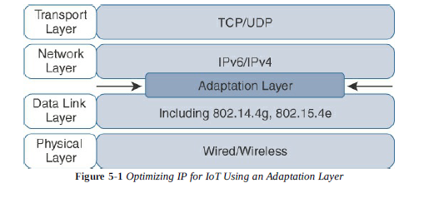
Optimizing IP for IoT
Internet protocol is the key for a successful IoT environment. Constrained nodes and constrained networks require optimization of IP architecture at various layers.
Various existing technologies have already optimized the IP architecture by introducing a new layer called “Adaptation Layer”.

Slide 9
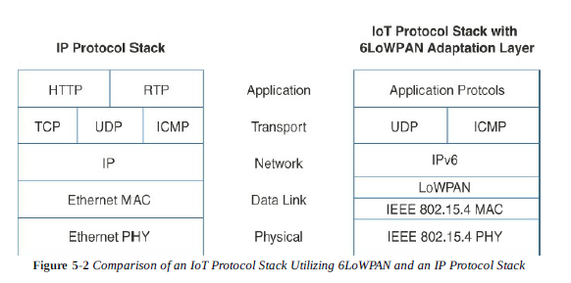
From 6LoWPAN to 6Lo:
The model for packaging IP into lower-layer protocols are referred as an “adaptation layer”.
The adaptation layer designed for IoT may include some optimizations to deal with constrained node networks. The example of adaptation layers optimized for constrained nodes are under 6LoWPAN working group and its successor, the 6Lo working group.
The initial focus of 6LoWPAN was to optimize the transmission of IPV6 packets over constrained networks such as IEEE 802.15.4

Slide 10
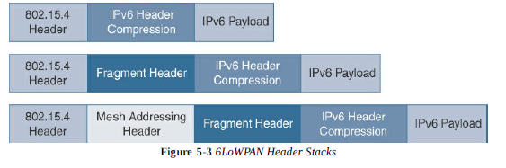
6LoWPAN:
Headers can be stacked in the adaptation layer to keep header compression, fragmentation and mesh addressing

Slide 11
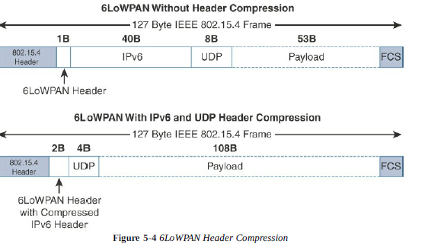
Header Compression
This technique shrinks the size of IPV6’s 40-byte headers and UDP’s 8-byte headers down as 6 bytes combined.
6LoWPAN only supports IPV6, so the compression is applicable to only IPV6 header.
It takes shared information known by all nodes from their participation in the local network and omits some standard header fields

Slide 12
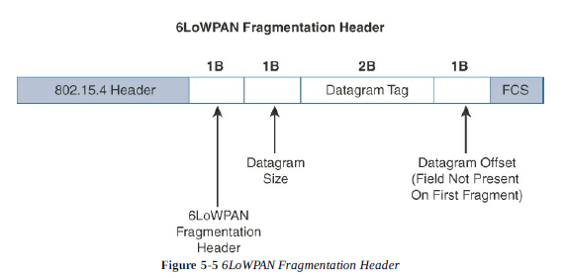
Fragmentation
The MTU for an IPV6 network must be at least 1280 bytes.
Large IPV6 packets are fragmented in to multiple frames at layer-2.
Datagram size-> total size of unfragmented payload
Datagram tag-> set of fragments for a payload
Datagram offset-> how far into a payload a particular fragment occurs

Slide 13
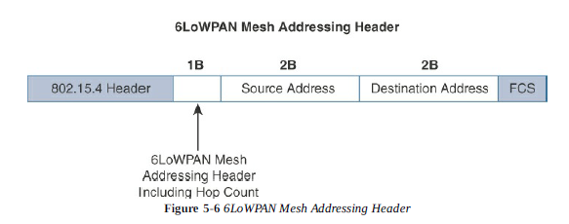
Mesh Addressing
It is used to forward packets over multiple hops.
3 fields are defined for this header:
Hop limit: how many times a frame can be forwarded
Source address:
Destination Address:
The mesh addressing is used in a single IP subnet and is a layer-2 type of routing known as mesh-under

Slide 14
Mesh-under Vs Mesh-over
Mesh-under:
The routing packets are handled at the 6LoWPAN adaptation layer
Utilizes 6LoWPAN mesh addressing header to route an forward packets at the link layer
The term mesh-under is used, because multiple link layer hops can be utilized to complete a single IP hop.
Nodes have layer-2 forwarding table to route the packets to final destination
An edge gateway terminates the mesh-under domain.
The edge gateway is used to translate the configured layer2 protocol and any IP routing mechanism implemented on other layer-3 IP interfaces.
Mesh-over:
Utilizes IP routing
Each full functioning node acts as an IP router, so each link layer hop is an IP hop.
For smart objects using mesh-over, a special routing protocol is required called RPL.

Slide 15
6Lo Working group:
Focused on IPV6 connectivity over constrained-node networks, now called as IPV6 over networks of Resource-Constrained Nodes.
6LO Working group is focused on the following:
IPV6 over adaptation layer specifications: IPV6 over low energy, over near-field communication, over 802.11ah, over ultra low energy, over wireless networks for industrial automation, over master-slave passing
Information and data models such as MIB modules: definition for managed objects for IPV6 over low-power wireless personal area networks
Optimizations that are applicable to more than one adaptation layer specification: generic header compression for IPV6 over low-power wireless personal area networks
Informational and maintenance publications needed for the IETF specifications in this area.

Slide 16
Routing over Low-power and Lossy Networks (RPL)
According to the characteristics and requirements of constrained networks, a new routing protocol is developed for use by IP smart objects.
This new distance vector routing protocol was named the IPV6 Routing Protocol for Low Power and Lossy Networks (RPL).
In RPL, each node acts as a router and becomes part of a mesh network.
Each node examines every received IPV6 packet and determines the next hop destination.
Depending on the constraints of computing and memory, the RPL protocol defines 2 modes:
Storing mode: all nodes contain the full routing table of the RPL domain. Every node knows how to reach other nodes.
Non-storing mode: only the border routers of the RPL domain contain the full routing table. All other nodes in the domain only maintain their list of parents and use this as a list of default routes towards the border router (saves memory and CPU).
RPL is based on the concept of DAG

Slide 17
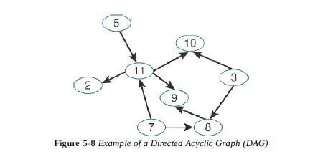
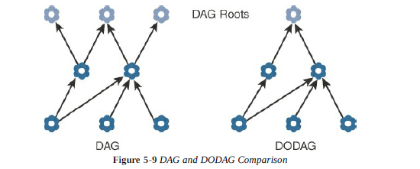
A basic RPL involves building a destination-oriented directed acyclic graph (DODAG). DODAG is a DAG rooted to one destination. In RPL, the destination occurs at a border router known as DODAG root.
In DODAG, each node maintains up to 3 parents that provide a path to the root. One of these parents is preferred parent, which means, it is the preferred next hop for upward routes toward the root.

Slide 18
Routing graph created by the set of DODAG parents across all nodes defines the full set of upward routes.
The RPL implementation ensures that the routes are loop free by disallowing nodes from that are positioned further away from the border router.
Upward routes in RPL are discovered and configured using DAG Information Object (DIO) messages. Nodes listen to DIOs to handle changes in the topology. The information in the DIO messages determines parents and the best path to DODAG root.
Nodes establish downward routes by advertising their parent set toward the DODAG root using a Destination Advertisement Object (DAO) message. DAO messages allow nodes to inform their parents of their presence and reachability to descendants.
In case of non-storing mode, the nodes sending DAO messages report their parent sets directly to the border router (DODAG root). The root uses the information to determine source routes to individual nodes downstream in the mesh.

Slide 19
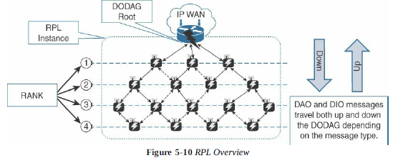
For storing mode, each node keeps track of the routing information that is advertised in the DAO messages.
Packets can take shorter paths between destinations in the mesh though it consumes more power and it is CPU-intensive.
RPL messages, such as DIO and DAO, run on top of IPV6. DAO and DIO messages move both up and down the DODAG, depending on the exact message type

Slide 20
Objective Function (OF): An OF defines how metrics are used to select routes and establish a node’s rank. Whenever a node establishes its rank, it simply sets the rank to the current minimum expected number of transmissions among its parents.
Rank: is a rough approximation of how “close” a node is to the root and helps avoid routing loops and the count-to-infinity problem. Nodes can only increase their rank when receiving a DIO message with a larger version number. Nodes decrease their rank whenever they have lower-cost routes.
RPL Headers: specific network layer headers are defined for datagrams being forwarded within the RPL network.
RFC 6553 used to carry hop-by-hop header
RFC 6554 specifies the space routing header (SRH) used in RPL routers. SRH specifies a source route to deliver datagrams to nodes downstream in the mesh network.
Metrics: RPL supports flexible set of metrics to support battery-powered nodes. Following are some of them:
Expected Transmission Count (ETX)-> assigns discrete value to the number of transmissions a node expects to deliver a packet.

Slide 21
2. Hop count-> number of nodes traversed in a path.
3. Latency-> varies with power conservation.
4. Link quality level-> measures the reliability of a link by taking packet error rates into account
5. Link color-> sets values to make a link more or less desirable (used for different traffic type)
6. Node state and attribute-> identifies nodes that function as traffic aggregators and nodes that are impacted by high workloads.
7. Node energy-> avoids node with low power.
8. throughput-> provides the amount of throughput for a node link.
Constraints: ETX and RSSI (relative signal strength indicator)
RSSI->link quality(programmed constraints: RSSI exceeds a threshold and ETX falls below a threshold)

Slide 22
Chapter-6: IoT Application protocols
IoT application protocols are dependent on characteristics of the lower layers.
The Transport Layer: The constrained nature of IoT networks requires a closer look at the use of TCP or UDP mechanisms along with IP.
IoT Application Transport Methods: Various types of IoT application data and the ways this data can be carried across network.
The Transport Layer: TCP->industrial application layer protocols, cellular networks; UDP->CoAP, multicast operations

Slide 23
IoT Application Transport Methods:
Categories of IoT transport methods:
Application layer protocol not present-> data payload is directly transported on top of the lower layers(no application layer protocol is required)
Supervisory control and data acquisition(SCADA)-> most common industrial protocol, designed before IP, has been adapted for IP network
Generic web-based protocols-> such as Ethernet, wi-fi,4G/LTE are communicating over non-constrained networks
IoT application layer protocols-> are devised to run on constrained nodes; MQTT(message queue telemetry transport) and CoAP(constrained application protocol) are 2 well known examples

Slide 24
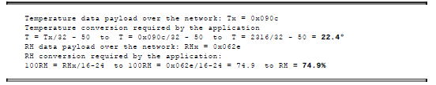
Application layer protocol not present
Class 0 or severely constrained nodes do not implement a fully structured network protocol stack; IP, TCP or UDP, or an application layer protocol.
Ex: low-cost temperature and relative humidity sensor (RH) sending data over a LoRaWAN infrastructure
(Decoding temperature and and RH sensor data)

Slide 25
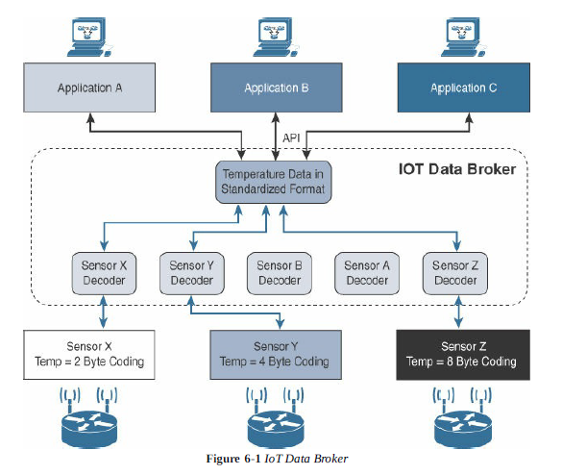

Slide 26
SCADA
Older protocols that connected sensors and actuators have evolved and adapted themselves to utilize IP. A prime example is supervisory control and data acquisition (SCADA).
SCADA is an automation control system initially implemented without IP over serial links, before being adapted to Ethernet and IPV4.
SCADA system collects sensor data and telemetry from remote devices and also having ability to control them.
Now-a-days, SCADA is allow global, real-time, data-driven decisions to be made about how to improve business process.
It is mainly used in manufacturing/industrial verticals. Ex: Modbus protocol,DNP3 protocol
To be compatible with current IoT networks, these protocols require certain accommodations and adjustments.

Slide 27
Adapting SCADA for IP
Benefits of moving to Ethernet and IP from the non-IP protocols include the ability to leverage existing equipment and standards while integrating seamlessly the SCADA subnetworks to the corporate WAN infrastructures.
Further benefits include updation of protocol specification and documentation of IP for each protocol. This also includes assignment of TCP/UDP port numbers to the protocols, such as following:
DNP3 specifies the use of TCP or UDP on port 20000 for transporting DNP3 messages over IP.
The Modbus messaging services utilizes TCP port 502.
DLMS user association specified a communication profile based on TCP/IP allowing data exchange via IP and port 4059.
These protocols have adapted and evolved to utilize IP and TCP/UDP as both networking and transport mechanisms.

Slide 28
Use case: DNP3
DNP3 is based on master/slave relationship.
Master refers to a powerful computer located in the control center, and a slave is a remote device with computing resources found in a location such as substation. In DNP3 slave specifically means outstations.
Outstations monitor and collect data from devices that indicate their state, such as whether a circuit breaker is on or off, and take measurements, including voltage, current, temperature and so on.
This data is then transmitted to the master when it is requested. The master also issue control commands, such as to start a motor or reset a circuit breaker.

Slide 29
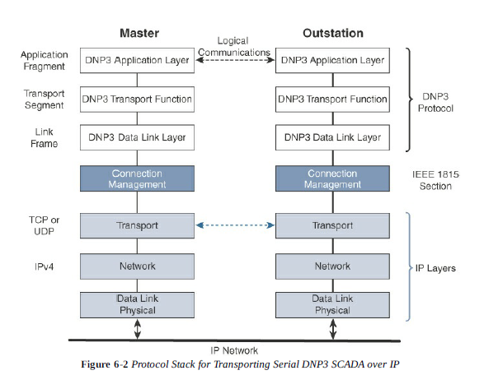
TCP active open TCP passive open
Dual end point is a process that listens for both connection requests and perform an active open on the channel

Slide 30
Master stations may send multiple DNP3 data link layer frames from a single UDP datagram, but DNP3 data link layer frames can not span multiple UDP datagrams.
Single or multiple connections to the master may get established while a TCP keepalive timer monitors the status of the connection.
Keepalive messages are implemented as DNP3 data link layer status requests.
If a message is not received to a keepalive message, the connection is deemed broken, and the appropriate action is taken.

Slide 31
Tunneling legacy SCADA over IP networks
Deployment of legacy industrial protocols, call for flexibility when integrating several generations of devices with various versions of application servers. For this native IP support is preferred by (1) tunneling using raw sockets over TCP or UDP (2) by installing and intermediate device that performs protocol translation between serial protocol version and its IP implementation.
A raw socket connection denotes that the serial data is being packaged directly into a TCP or UDP transport. Modern industrial application servers support this capability.
Older industrial applications require another device or software to handle the translation from pure serial data to serial over IP using raw socket.

Slide 32
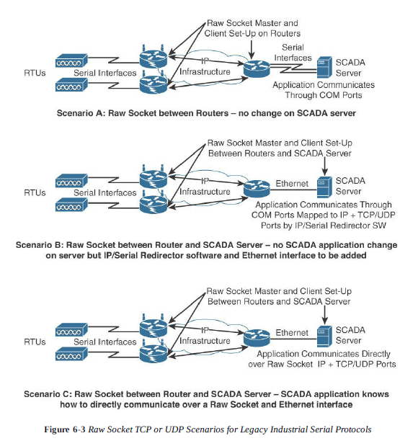
Native raw sockets

Slide 33
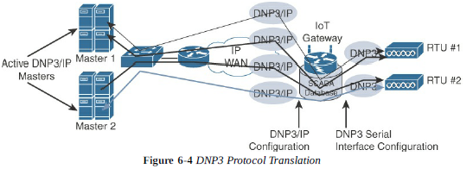
SCADA protocol Translation
With protocol translation, the legacy serial protocol is translated to a corresponding IP version.
The IoT gateway implements a computing function close to the edge helps scale distributed intelligence in IoT networks.

Slide 34
SCADA transport over LLNs with MAP-T
Due to the constrained nature of LLNs, the implementation of industrial protocols need minimum UDP. This requires that both the application servers and devices support and implement UDP.
But the implementation of SCADA and legacy industrial protocols support IPV6, and the industrial devices support IPV4 only.
When deployed over LLN subnetworks that are IPV6 only, a transition mechanism, such as MAP-T(mapping of address and port using translation), needs to be implemented.
MAP-T allows legacy IPV4 traffic to be forwarded across IPV6 networks.(older devices and protocols continue with IPV4 even though network requires IPV6).

Slide 35
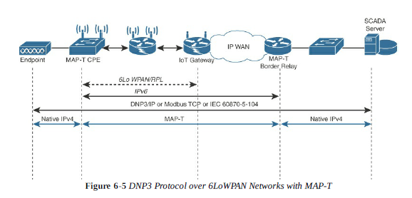

Slide 36
Generic Web-Based Protocols
On non-constrained networks, such as Ethernet, Wi-Fi, 3G/4G, where bandwidth is not a potential issue, data payloads on data model representation, including XML or JSON, can be transported over HTTP/HTTPS or WebSocket. (similar to development of web application)
For some constrained devices embedded web server software is used for web application development which supports HTTP/HTTPS.
IoT devices that only push data to an application(ex: weather map application, health application), implements web services on client side using HTTP
IoT devices uses real-time communication such as video surveillance camera, instant messaging, implements XMPP(extensible messaging and presence protocol) protocol.
For accessing web services IoT uses SOAP(simple object access protocol) and REST(representational state transfer protocol)

Slide 37
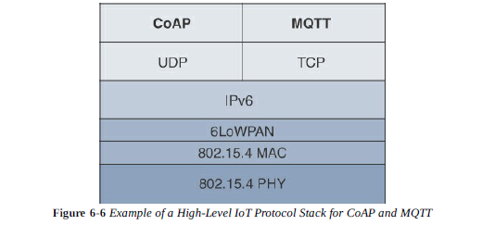
IoT Application Layer Protocols
Web-based and data model protocols are too heavy for IoT applications. Two light weight protocols are better suited to large number of constrained nodes and networks are CoAP and MQTT.
CoAP deployed over UDP and MQTT running over TCP.

Slide 38
CoAP(Constrained Application Protocol)
CoAP provides a generic framework for resource-oriented applications targeting constrained nodes and networks.
It defines simple and flexible ways to manipulate sensors and actuators for data or device management.
CoAP is having multiple-standards-track specifications as follows:
RFC 6690: Constrained RESTful Environments (CoRE) Link format
RFC 7252: Constrained Application Protocol (CoAP)
RFC 7641: Observing resources in the Constrained Application Protocol
RFC 7959: Block-wise transfers in the Constrained Application Protocol
The CoAP messaging model is designed to facilitate the exchange of messages over UDP between end points, including the secure transport protocol datagram transport layer security (DTLS).

Slide 39
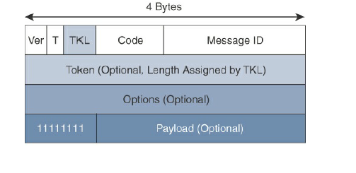
RFC 7252 specifies securing CoAP with DTLS. It ensures how a CoAP endpoint is provisioned with keys and filtering list.
Four types of security modes are defined in CoAP: NoSec, NoSharedKey, RawPublicKey, and Certificate.
(CoAP Message Format)
CoAP message is composed of a short fixed-length header filed(4 bytes), a variable-length but mandatory token field(0-8 bytes), options and payload field.

Slide 40
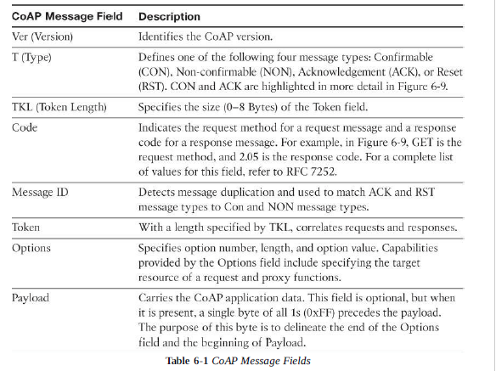
CoAP message format allows to deliver low overhead, while being easy to parse and process for constrained devices.

Slide 41
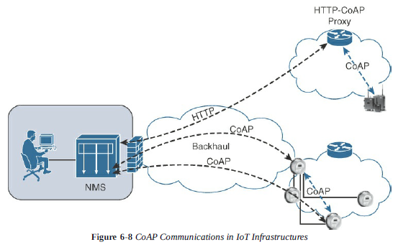
CoAP can run over IPV4 or IPV6. However, it is recommended to fit the message within a single IP packet and UDP payload to avoid fragmentation.
CoAP message size is 1152 bytes, including 1024 bytes for the payload.
CoAP does not rely on IP fragmentation, but refines a pair of Block options for transferring multiple blocks of information from resource representation in multiple request/response pairs.

Slide 42
CoAP supports proxy mechanisms, defined in RFC7252 where a basic HTTP mapping for CoAP is also defined.
Just like HTTP, CoAP is also based on the REST architecture, where both client and server are “things”.
Through exchange of “asynchronous messages”, a client requests an action via method code on a server resource.
Using URI, the server identifies the resource and responds with a response code.
The CoAP request/response semantics include GET, POST, PUT, and DELETE methods.
The coap/coaps URI scheme identifies a resource, including host information and optional UDP port, indicated by the host and port parameters
coap-URI= “coap:” “//” host [“:”port] path-abempty [“?” query]
coaps-URI= “coaps:” “//” host [“:”port] path-abempty [“?” query]

Slide 43
CoAP supports 4 types of messages: confirmable, non-confirmable, acknowledgement, and reset.
CoAP code, method and response codes, option numbers, and content format have been assigned by IANA as Constrained RESTful Environments (CORE) parameters.
When a CoAP header is marked as “confirmable” it offers reliable transmission of messages over UDP.
In addition, it supports basic congestion control with a default time-out, simple stop-and-wait retransmission with exponential back-off mechanism, and detection of duplicate messages through a message ID.
If a request or response is “confirmable”, the recipient must acknowledge or reject the message, using the same message ID.
If a recipient can not process a non-confirmable message, a reset message is sent.

Slide 44
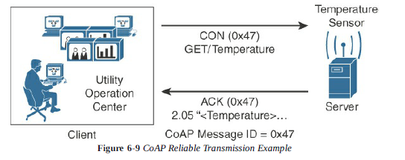
CoAP supports data requests sent to a group of devices by using IP multicast.
The IPV4 multicast address is 224.0.1.187, and for IPV6 is FFOX::FD using default CoAP port 5683.
Endpoints can find available CoAP services through multicast service discovery.
A typical use case for multicasting in CoAP is smart meters.
The services provided by CoAP servers can either be discovered by learning URI or through the “all CoAP nodes” multicast address.

Slide 45
Port number 5683 is used for discovering the services for non-secured CoAP, and for secured CoAP the port number is 5684.
One default standard is defined for accessing the web server resources by CoRE group which is a well known relative URI, such as /.well-known/core.
To improve the response time and reduce the bandwidth consumption, CoAP supports caching capabilities based on the response code.
For a cache entry, CoAP endpoints validate the request and store the response for all options. This confirms that the stored response is valid.
Summary:
CoAP is fully optimized for IoT constrained nodes and networks, while supporting traditional web programming techniques to make it easily understandable by the development community.

Slide 46
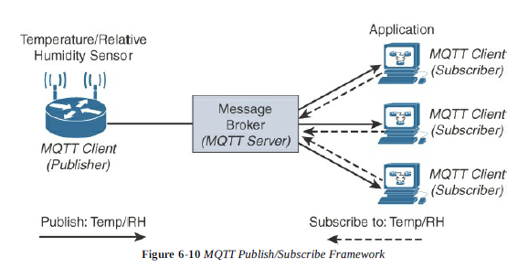
Message Queuing Telemetry Transport (MQTT)
MQTT is a reliable, lightweight, cost-effective protocol used to monitor and control a large number of sensors and their data from central server location.
MQTT server handles the subscription and un-subscription process and pushes the application data to MQTT clients acting as subscribers.
Ex: Twitter

Slide 47
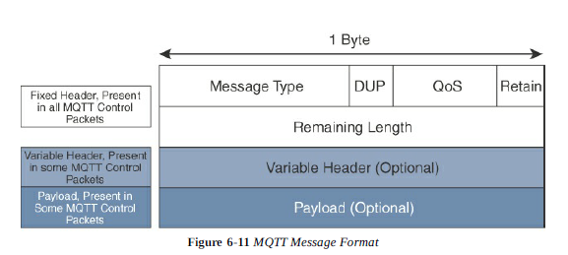
MQTT broker/server ensures that the data can be buffered and cached in case of network failures. Thus, publishers and subscribers need not have to be online at the same time.
MQTT transport packets run over TCP using port 1883 which ensures an ordered, lossless stream of bytes between the MQTT client and server.
MQTT is secured using TLS on port 8883, and WebSocket can also be used.
Each control packet is having 2 bytes fixed header and payload up to 256MB

Slide 48
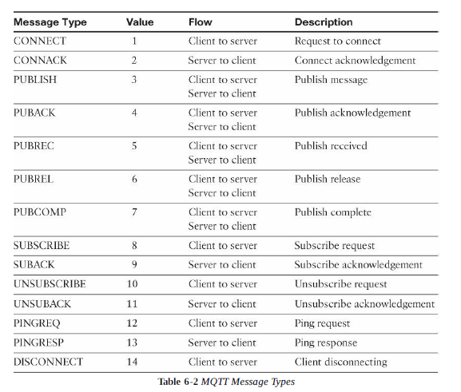
Message Type->identifies the kind of MQTT packet within a message. 14 different control packets are specified and each of them is coded with an unique value. Values 0 and 15 are reserved.

Slide 49
DUP-> Duplication flag when set, allows the client to notate that the packet has been sent previously, but an acknowledgement was not received.
QoS-> allows for the selection of 3 different QoS levels.
Retain-> only found in PUBLISH message. It notifies the server to hold onto message data. Allows the subscribers to get the last known value without waiting for the next update from publisher.
Remaining length-> specifies the number of bytes in the MQTT packet
MQTT session between each client and server consists of 4 phases:
Session establishment
Authentication
Data exchange
Session termination

Slide 50
When the server is delivering an application message to more than one client, each client is treated independently using their unique client ID.
Subscription to resources generate SUBSCRIBE/SUBACK control packets, while un subscription is performed through the exchange of UNSUBSCRIBE/UNSUBACK control packets.
Graceful termination is done through DISCONNECT control packet (reconnection by resending unique client ID to resume the operations).
A message broker uses topic string or topic name to filter messages for its subscribers.
When subscribing to a resource, the subscriber indicates one or more topic levels to structure the topic name.
Forward slash (/) is used to separate each level in a topic tree and provides a hierarchical structure to the topic names.
Ex: adt/lora/adeunis/0018B2000000023A

Slide 51
One subscriber can have subscription to multiple topics at once using wildcard characters (ex: #-> matches any number of levels within a topic)
The multilevel wildcard represents the parent and any number of child levels.
Ex: adt/lora/adeunis/# results the whole subtree as follows
adt/lora/adeunis/0018B2000000E9E
adt/lora/adeunis/0018B2000000E8E
adt/lora/adeunis/0018B2000000E9A
The + is a wildcard character that matches only one topic level.
Ex: adt/lora/+ allows to access adt/lora/adeunis or adt/lora/abeeway
Topic names begin with $ are used for message broker internal statistics and deleted by the server when subscriptions starts with wildcard characters.
Ex: a subscription to +/monitor/Temp does not receive any messages published to $SYS/monitor/Temp. This topic could be the control channel for the temperature sensor.

Slide 52
PINGREQ/PINGRESP control packets are used to validate the connections between the client and server.
Securing MQTT connections through TLS is considered optional because it calls for more resources on constrained nodes.
When TLS is not used, the client sends a clear-text username and password during the connection initiation.
QoS for MQTT is implemented when exchanging application messages with publishers and subscribers
The delivery protocol is symmetric, i.e., client and server can each take the role of either sender or receiver.
Delivery protocol-> delivery of an application message from a single sender to a single receiver.

Slide 53
MQTT protocol offers 3 levels of QoS
QoS 0: is the best-effort and unacknowledged data service referred to as “at most once” delivery. Message arrives either once or not at all.
QoS 1: ensures the message delivery between the publisher and server and then between the server and subscribers occurs at least once. It uses PUBLISH and PUBACK as message identifier. It guarantees “at least once” delivery using ACK.
QoS 2: used when neither loss nor duplication of messages is acceptable. Each packet contains an optional variable header with a packet identifier which increases the overhead. Confirming the receipt of a PUBLISH message requires 2-step acknowledgement process such as PUBLISH/PUBREC packet pair, and PUBREL/PUBCOMP packet pair. It provides a guaranteed service known as “exactly once” delivery, with no consideration for the number of retries.
The QoS process is symmetric where 2 separate transactions exist. One occurs between publishing client and MQTT server, another between MQTT server and subscribing client.

Slide 54
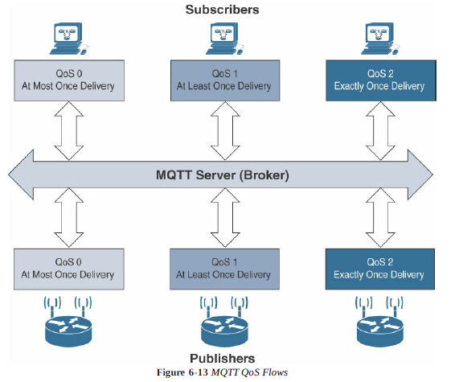
With CoAP, a wide range of MQTT implementations are now available. Ex: Facebook Messenger

Slide 55
